Slide 1







Autonomous Air transportation
AC Design
Using Vision Navigation
Flight test
Autopilot
Introduction
Implementation
Computer Vision
Supervised by: Asst. Prof. Osama Saaid

Slide 2
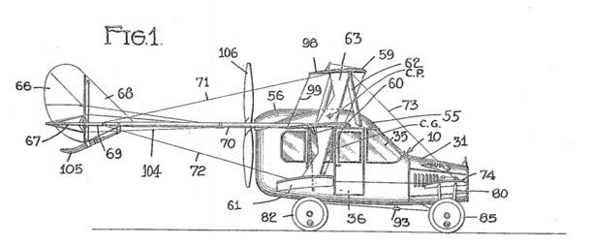

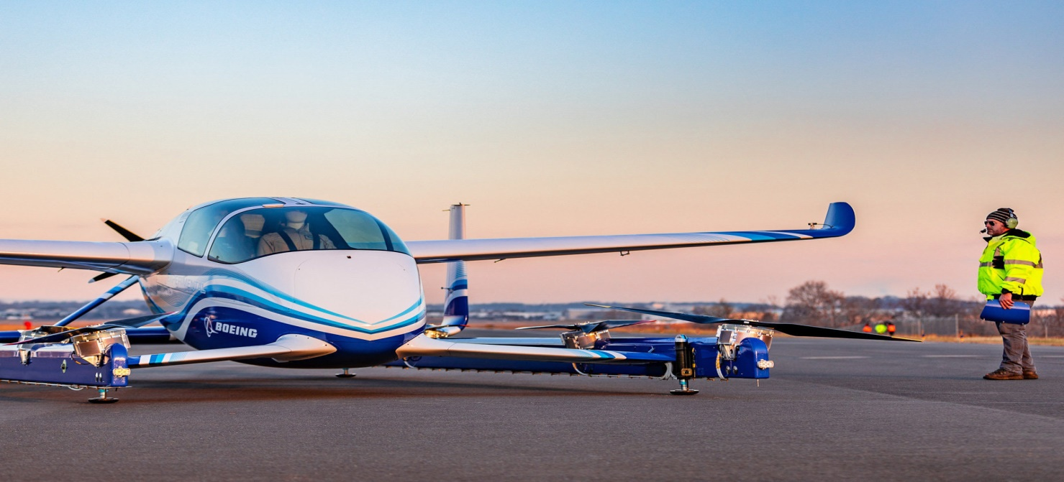
Flying Taxi
a flying vehicle with a range of 50 to 120 miles, carrying one to four passengers, and cruising at an altitude of 3,000 to 5,000 feet.
Introduction

Slide 3
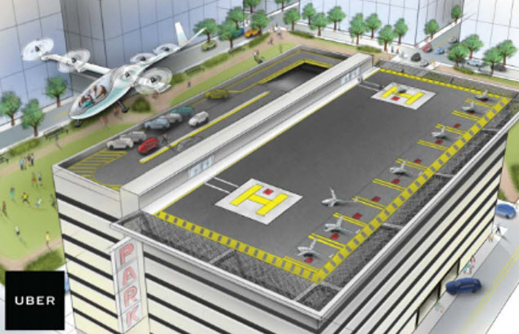
Why attractive idea
Traffic jam problem
Infrastructure cost
Reduce emission and improve safety
Obstacles we need to pass
Introduction
Energy limitations
The public is ready to fly aboard an air taxi with no pilot
Our current air traffic control systems doesn’t accommodate air taxies

Slide 4
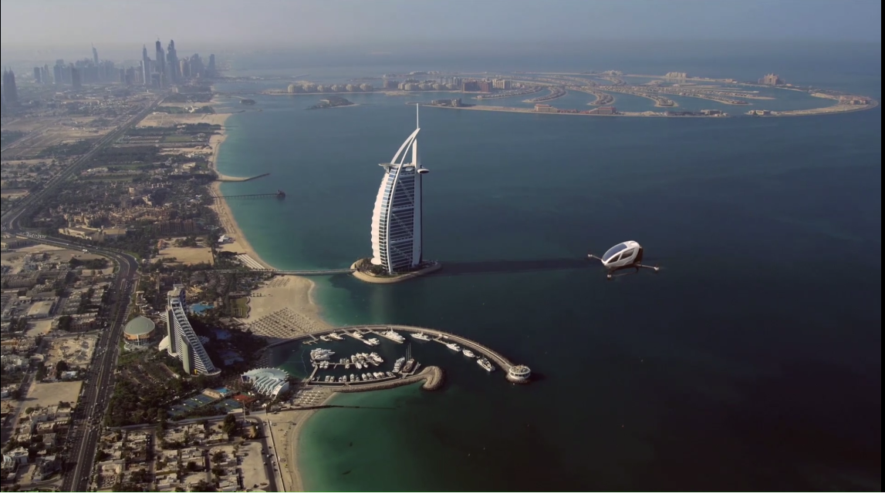
Flying taxi categories
Passenger drone:
Electric or hybrid electric
Move people or cargo
Manually piloted, remotely piloted or fully autonomous
Cover short to medium range up to 65 miles
will take flight by 2020
Introduction

Slide 5
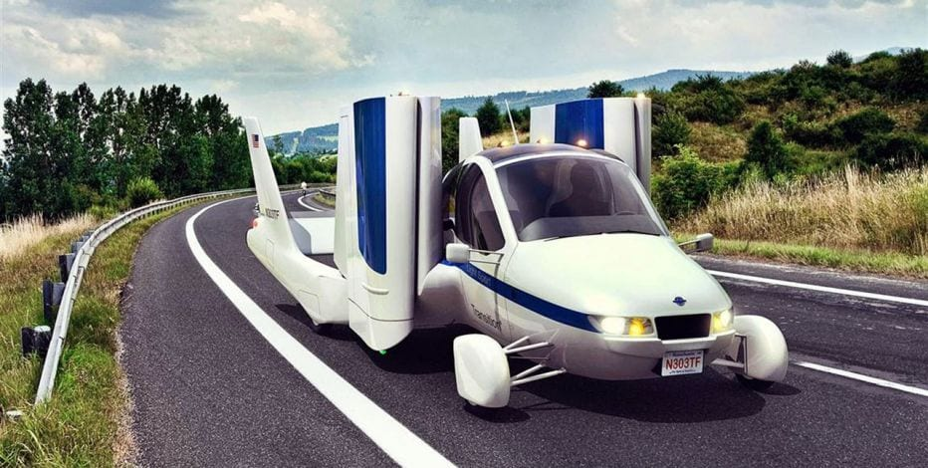
Flying taxi categories
Traditional flying cars:
Can be driven in car configuration to the airport then change it to airplane mode
Need licensed pilot
Cover medium to long range
will take flight by 2020-2022
Introduction

Slide 6
Flying taxi categories
revolutionary vehicles:
combine a passenger drone and traditional flying car
Fully autonomous vehicle
Cover long range (greater than 200 miles)
Have advanced VTOL capability
It could take until 2025 before they become a reality
Introduction

Slide 7
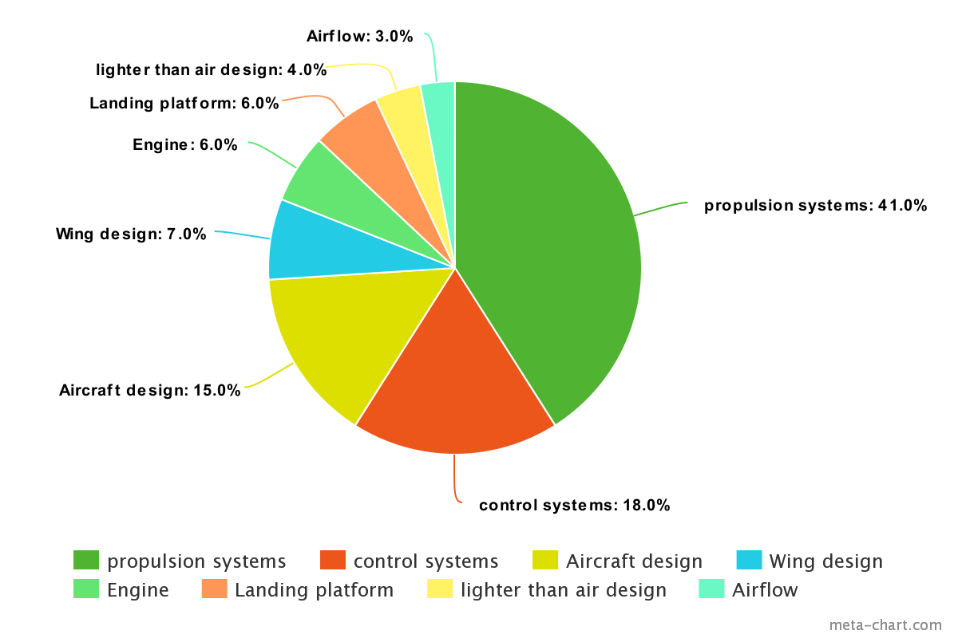
Technology areas dominating air taxi technology
Introduction

Slide 8






The key players in the flying car space
Introduction

Slide 9

The key players in the flying car space
Boeing flying taxi:
Has completed the first test of its autonomous electric VTOL
Introduction

Slide 10
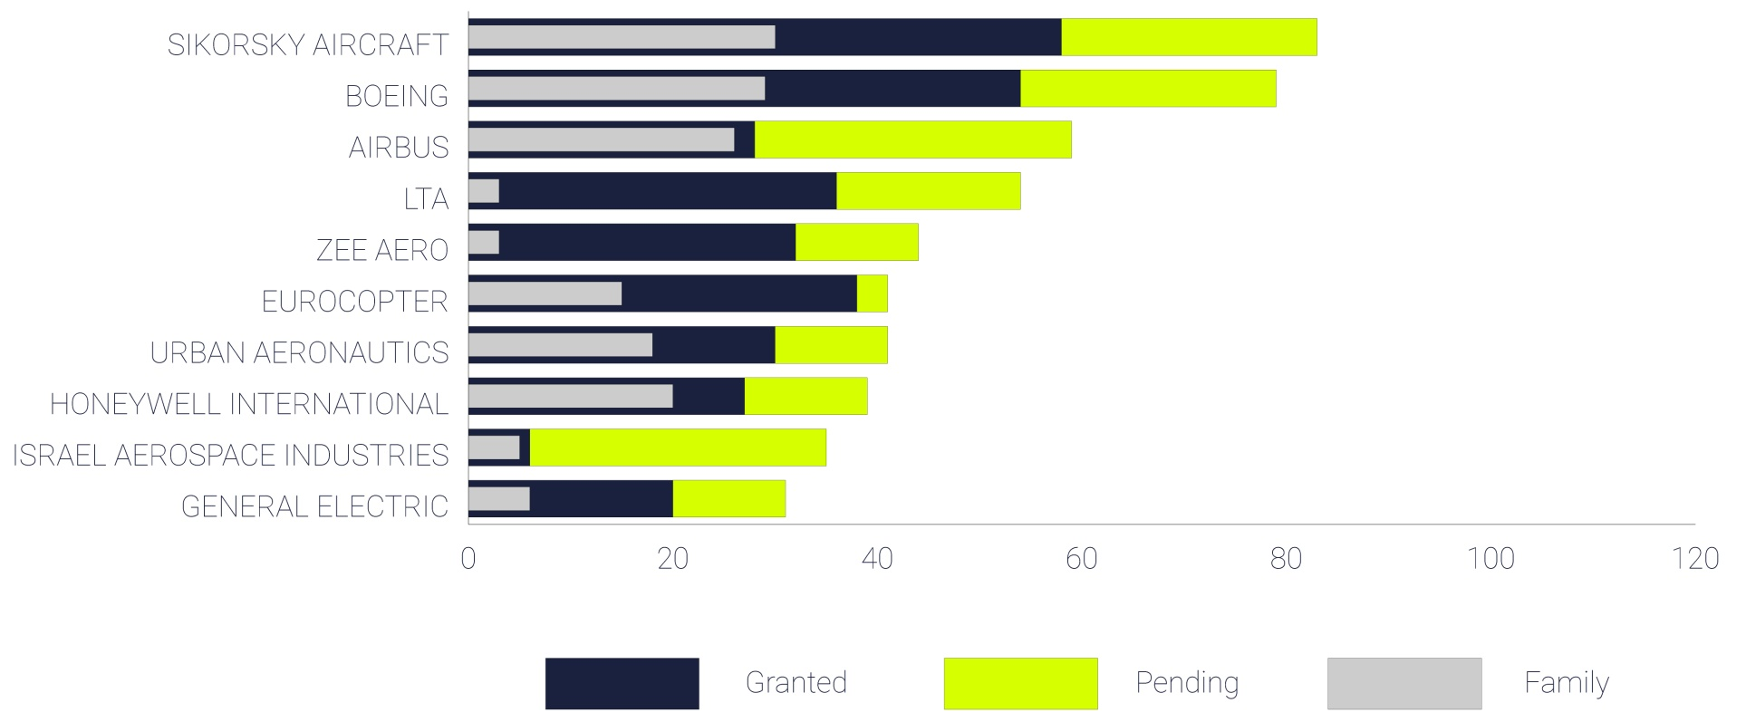
The key players in the flying car space
Patent portfolio:
Introduction

Slide 11
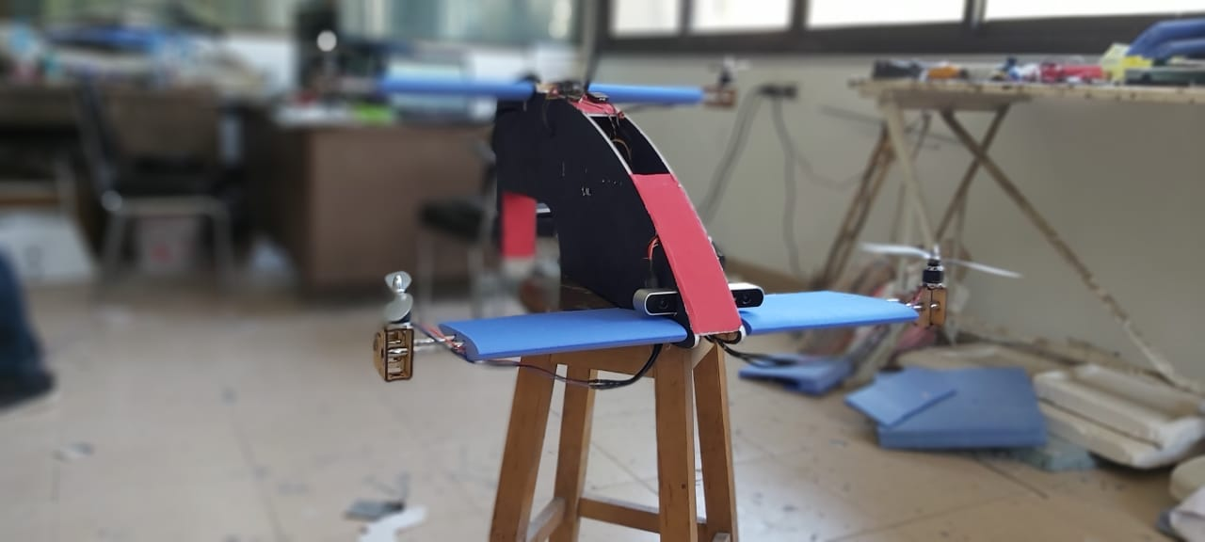
Our prototype
Introduction

Slide 12

AC Design

Slide 13

Autopilot

Slide 14

Computer Vision

Slide 15

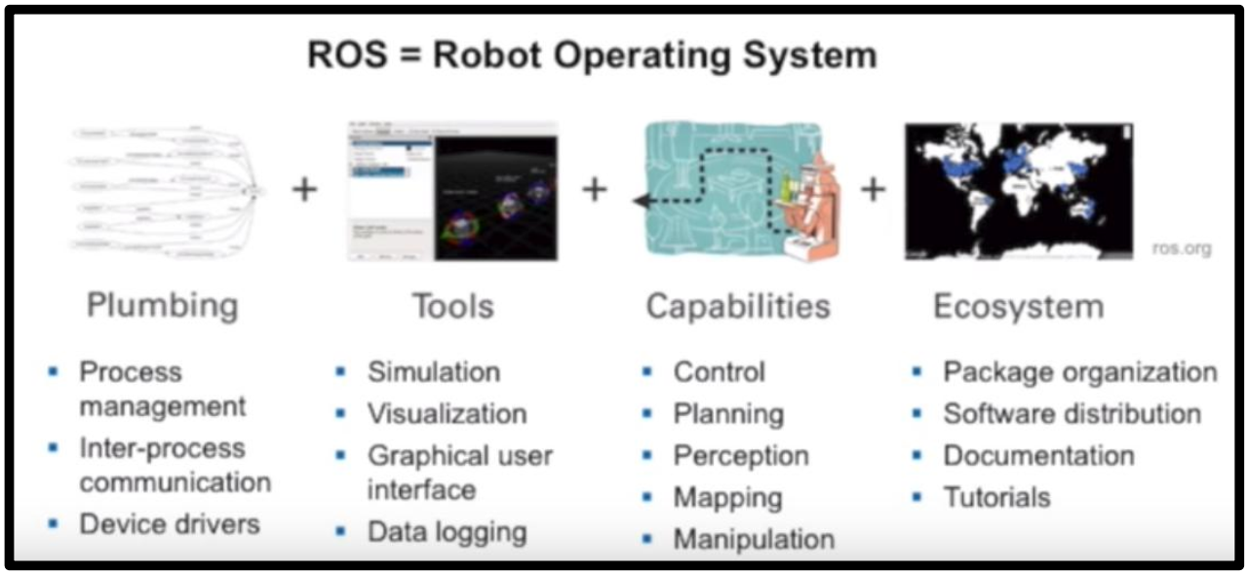

Implementation
Why ROS ?
Implementation

Slide 16
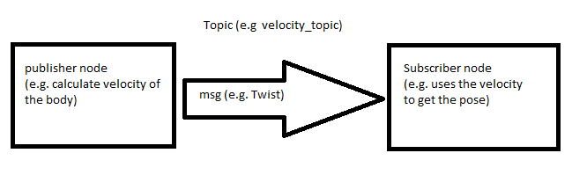
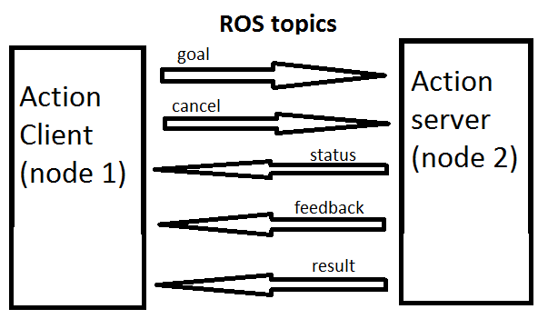
some important features in ROS
ROS master
ROS nodes
ROS topics
ROS messages
ROS packages
ROS services
ROS actions
Implementation

Slide 17
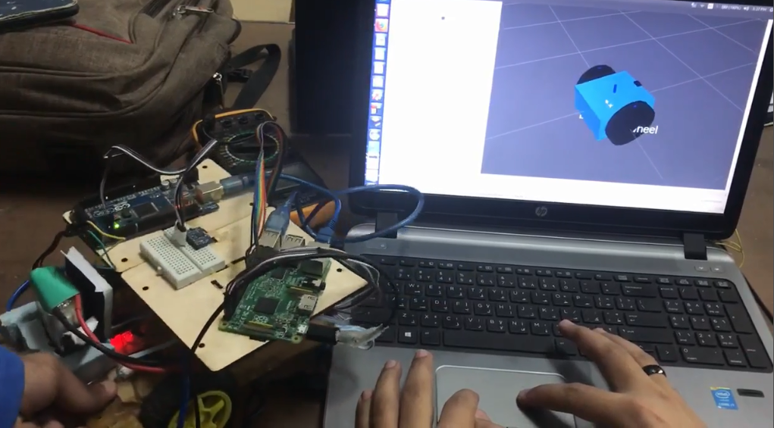
increase our experience in ROS and Its features
Deferential Drive Robot (DD robot)
Implementation

Slide 18
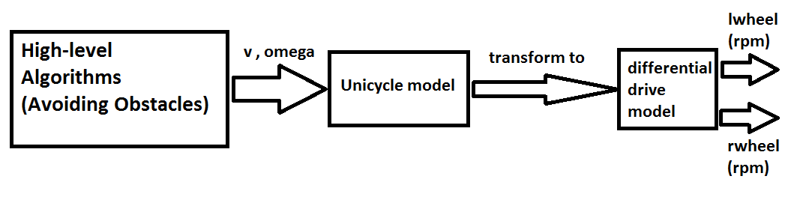
Modeling
Objective
Control the DD robot linear velocity and angular velocity
Localize the DD robot by fusing the data from IMU and odometry from encoders
Implementation

Slide 19
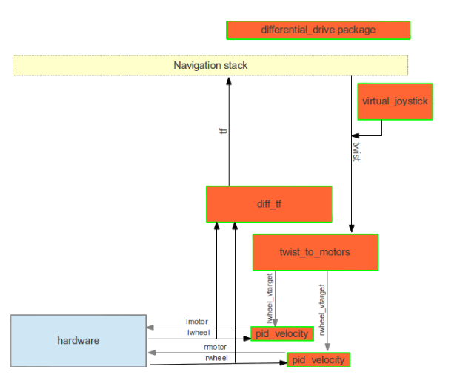
Block Diagram
Implementation

Slide 20
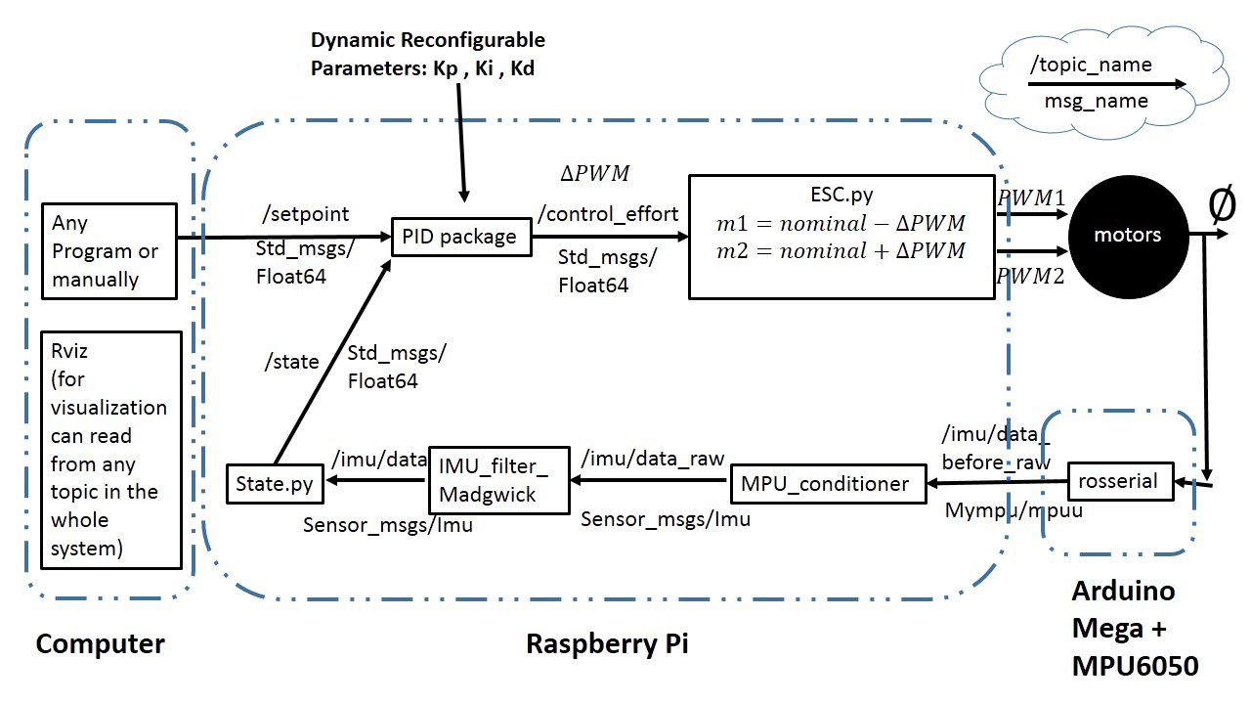
1D Bi-rotor
validate ROS performance in aerospace applications
Block Diagram
Conjuration 1 (ROS PID) (Low-pass filter on derivative term)
Implementation

Slide 21
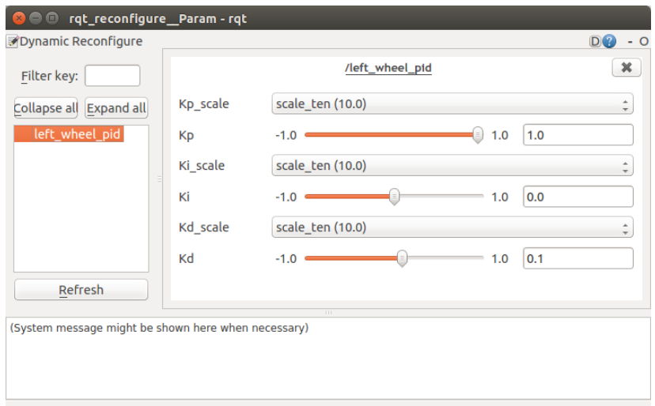
Controller Tuning in Real time
Implementation

Slide 22
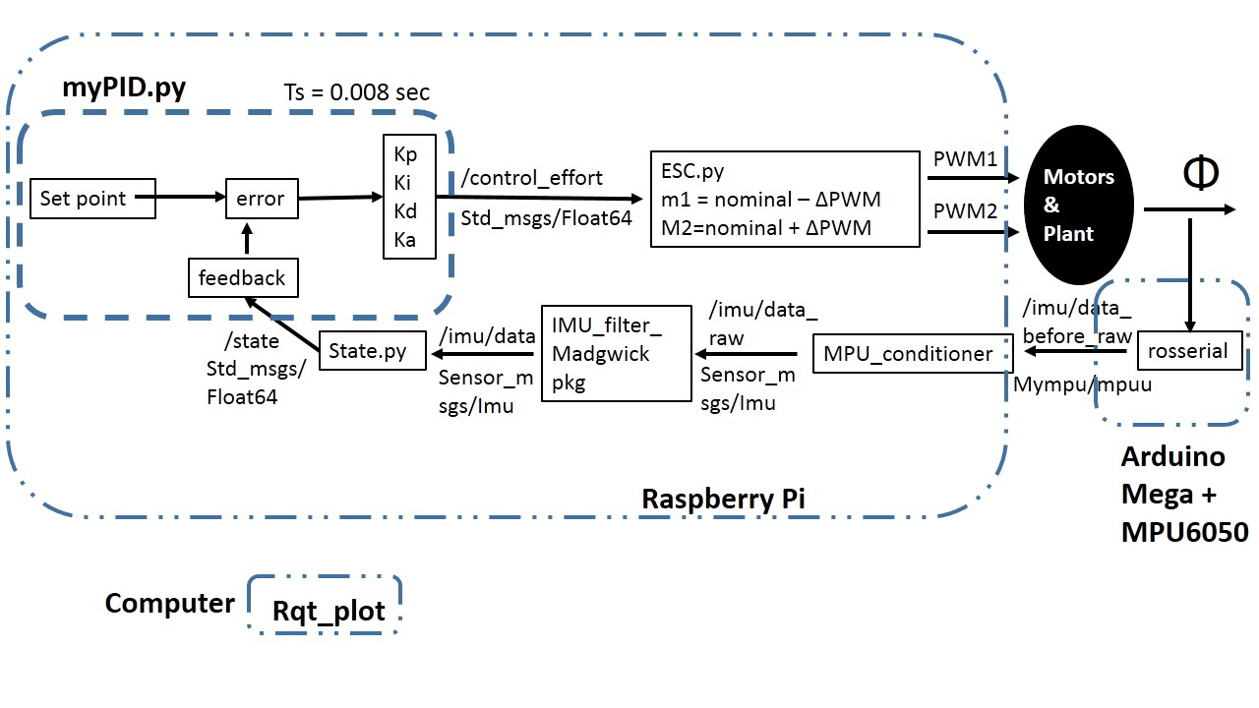
Configuration 2 (PIDA)
Implementation

Slide 23
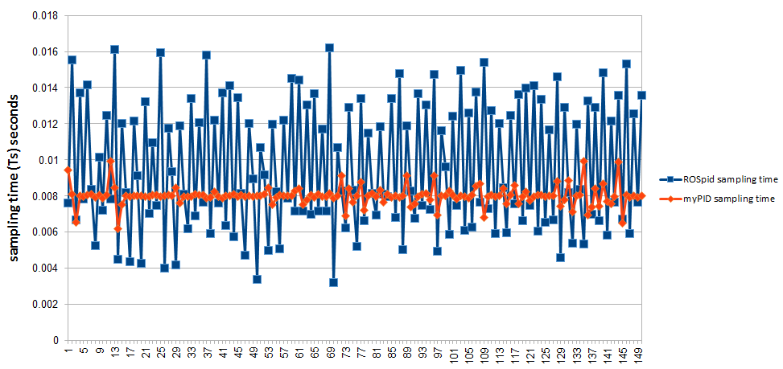
Results & Conclusions
Sampling Time
Comparison between configuration 1 and Configuration 2 sampling time
Implementation

Slide 24
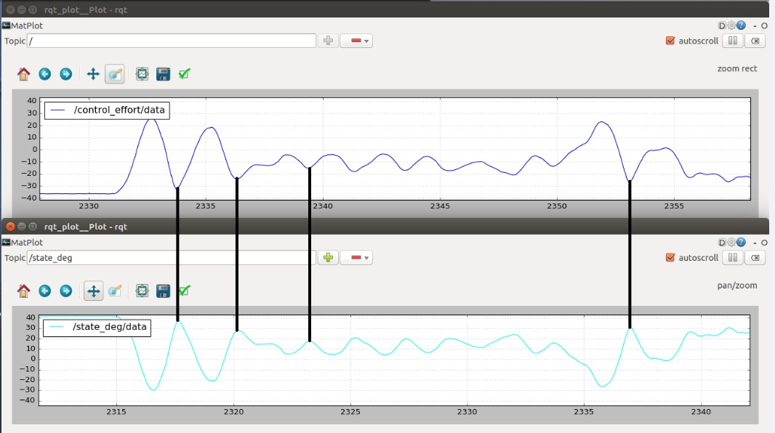
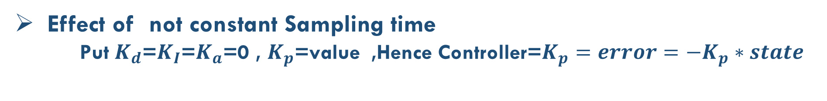
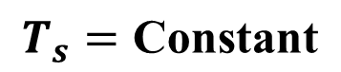
Effect of not constant Sampling time
Put $K_{d}$=$K_{I}$=$K_{a}$=0 , $K_{p}$=value ,Hence Controller=$K_{p}=error=−K_{p}∗state$
Implementation
$$T_{s}=\text{Constant}$$

Slide 25
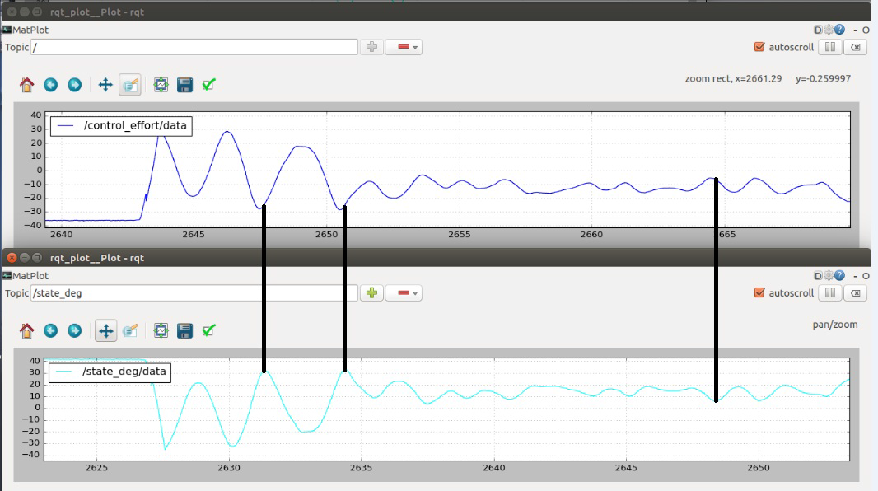
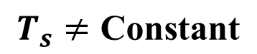
$$T_{s}≠\text{Constant}$$

Slide 26
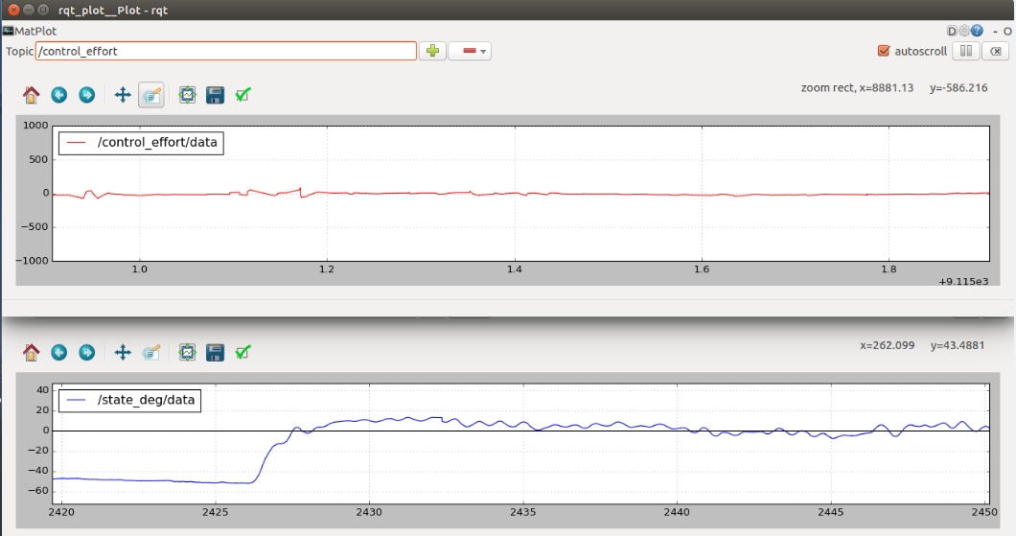
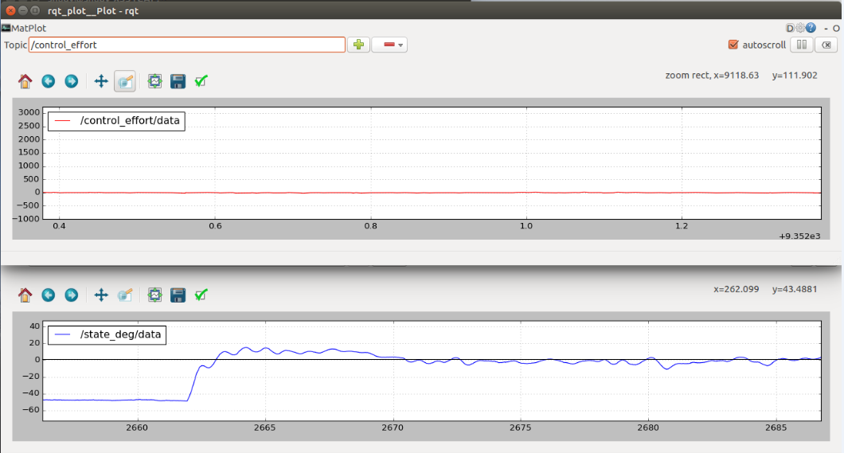
Gains tuning (Comparing between ROS and my PID controller)
Implementation
(a) $K_{p}=60 , K_{I}=10 , K_{D}=30$, cutto-freq (Low pass lter on derivative term) = 40 Hz

Slide 27
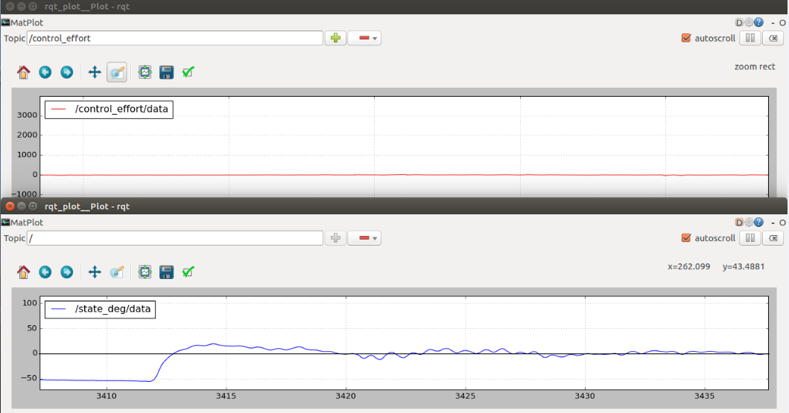
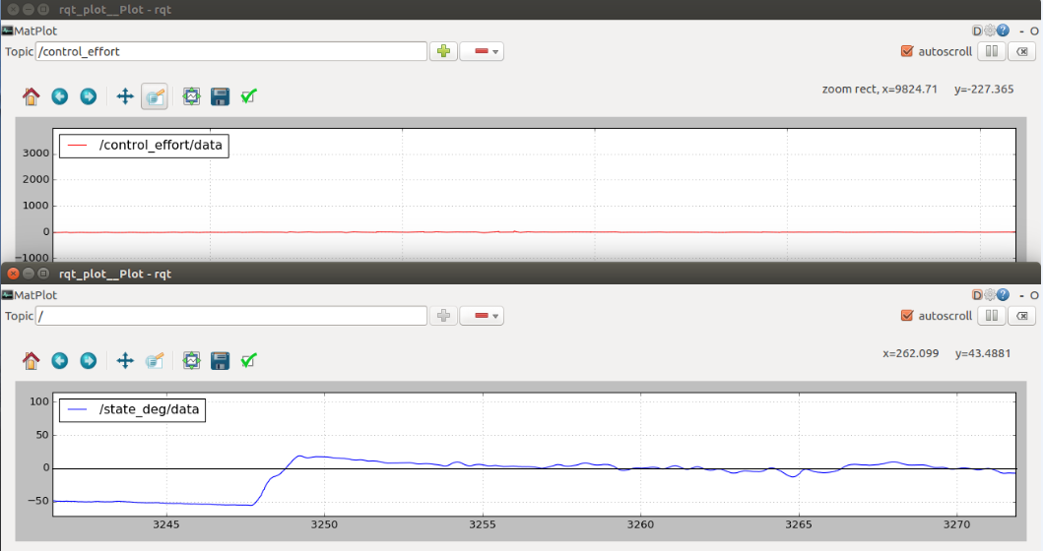
Gains tuning (Comparing between ROS and my PID controller)
Implementation
(b) ${ROS pid K}_{p}=60 , K_{I}=15 , K_{D}=30$, cutto-freq (Low pass lter on derivative term) = 40 Hz ,and same gains for my PID but adding $K_{a}=10$ (to resist error acceleration)

Slide 28
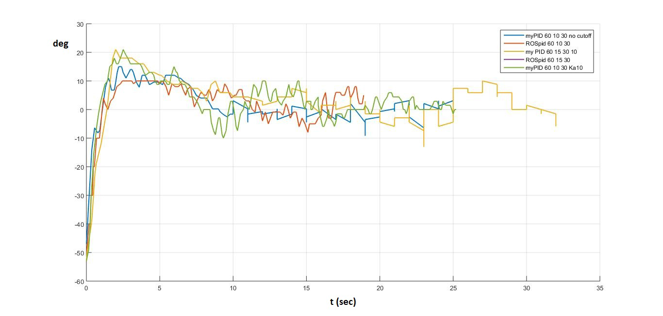
Comparing between ROS and my PID controller on one graph
Implementation

Slide 29
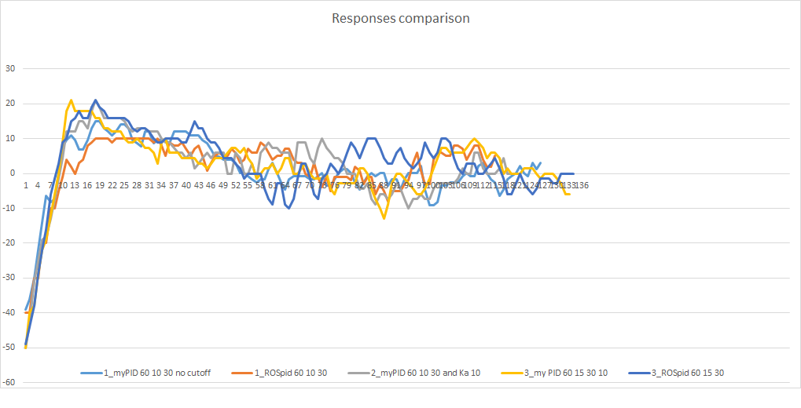
Comparing between ROS and my PID controller on one graph
Implementation

Slide 30
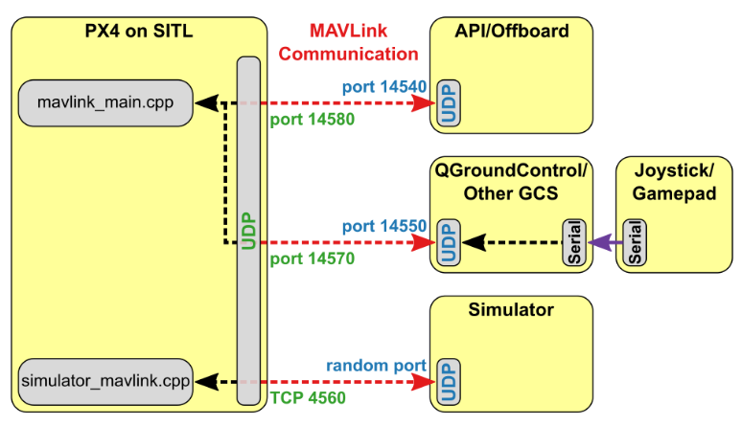
PX4 autopilot(PX4 , ROS and Gazebo)
Implementation

Slide 31
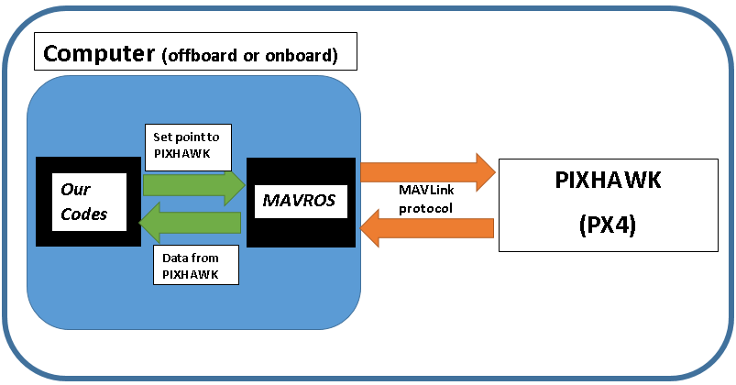
MAVROS and MAVLink messages interpretation
Implementation

Slide 32
VIDEO Position control
Position Control Using(PX4,Gazebo simulation,MAVROS)
Our simulation simple test
Implementation

Slide 33
Implementation

Slide 34

Flight test

